Slide 1
AutoML and AutoGluon
Machine Learning through Application
Module 1 – Lesson 5

Slide 2
Today’s activities
AutoML with AutoGluon
Module review

Slide 3
AutoML with AutoGluon

Slide 4
What is AutoML?
Codifies the best ML practices for data preparation, algorithm selection, and model training (including model tuning)
Automatically does the following tasks:
Preprocesses data according to its type
Splits data into train, test, and validation sets
Finds the best performing models and combinations of models
Finds the best model parameters

Slide 5
AutoGluon design principles
Simplicity:
Users can train a model on the raw data directly without knowing the details about the data and ML models.
Robustness:
It works with a variety of types of datasets and ensures that training succeeds even when some individual ML models fail.
Predictive timing:
It returns the results within the time budget that the user specifies.
Notes:
AutoGluon anticipates and handles model training failures automatically.
It also estimates future memory usage of individual models and skips expensive models, and only loads one model in memory at a time.
AutoGluon fails on far fewer datasets compared to other AutoML solutions.

Slide 6
Can AutoGluon beat data scientists?
With just 24 hours of training time, AutoGluon outperformed 99.3 percent of data scientists who participated in Kaggle competitions.
Notes:
Kaggle is an ML data science community with tools and resources, such as ML competitions, designed to help you get started and complete data science projects.
Reference:
Nick Erickson, Jonas Mueller, Alexander Shirkov, Hang Zhang, Pedro Larroy, Mu Li, and Alexander Smola, “AutoGluon-Tabular: Robust and Accurate AutoML for Structured Data,” arXiv (March 2020). https://doi.org/10.48550/arXiv.2003.06505.

Slide 7
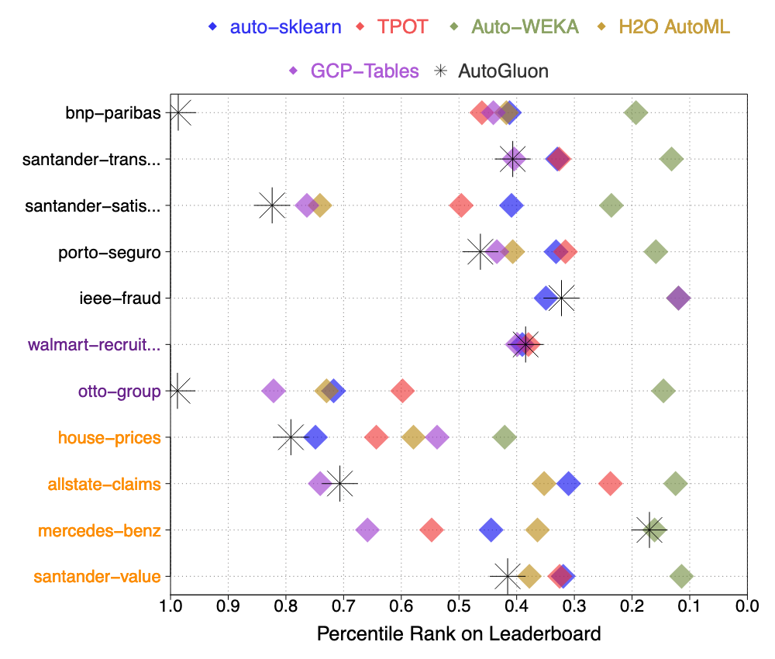
Can AutoGluon beat other AutoML frameworks?
AutoGluon also achieves the highest raw accuracy among AutoML frameworks when directly predicting class labels rather than probabilities.
Notes:
Reference:
Nick Erickson, Jonas Mueller, Alexander Shirkov, Hang Zhang, Pedro Larroy, Mu Li, and Alexander Smola, “AutoGluon-Tabular: Robust and Accurate AutoML for Structured Data,” arXiv (March 2020). https://doi.org/10.48550/arXiv.2003.06505.

Slide 8
Coding with AutoGluon
Only three lines of code to train and apply a model with tabular data (for example, book price prediction)
AutoGluon on GitHub: https://github.com/awslabs/autogluon
AutoGluon documentation: https://auto.gluon.ai/stable/index.html

Slide 9
Installing AutoGluon
# Code to install AutoGluon
pip3 install -U pip
pip3 install -U setuptools wheel
pip3 install autogluon
Installation: https://auto.gluon.ai/stable/index.html
Notes:
~Code block
~
This slide shows the code to install AutoGluon. The first two lines ensure that the system to install Python libraries are up to date. The tool that allows users to install Python packages is called pip. Setuptools is a library for packaging and distributing Python applications. Wheel is the standard for distribution of Python libraries.
Updating these ensures that the third line runs properly to install AutoGluon.

Slide 10
AutoGluon-Tabular: Three lines of code to train and use
from autogluon.tabular import TabularPredictor
predictor = TabularPredictor(label="Price").fit("train.csv")
predictions = predictor.predict("test.csv")
Runs AutoGluon and makes predictions
Notes:
~Code block

Slide 11
AutoGluon-Tabular: Three lines of code
label="Price"
Specifies the column that contains the label in the training dataset; here it is “Price”.
from autogluon.tabular import TabularPredictor
predictor = TabularPredictor(label="Price").fit("train.csv")
predictions = predictor.predict("test.csv")
fit ("train.csv")
Fits on the training dataset (learns the rules).
predictor.predict ("test.csv")
Predicts the label column for rows in a separate test dataset called “test.csv”
Notes:
~Code block

Slide 12
.fit() method
This method automatically does the following:
​Preprocesses raw data (identifies the type of each feature and converts the data to numerical values)
Identifies the type of prediction problem (for example, binary or multiclass classification, or regression)
​Splits data appropriately (for example, disjoint training/validation sets, K-fold split)
Individually trains various base models and creates an optimized combination (ensemble) that outperforms all the individual models

Slide 13
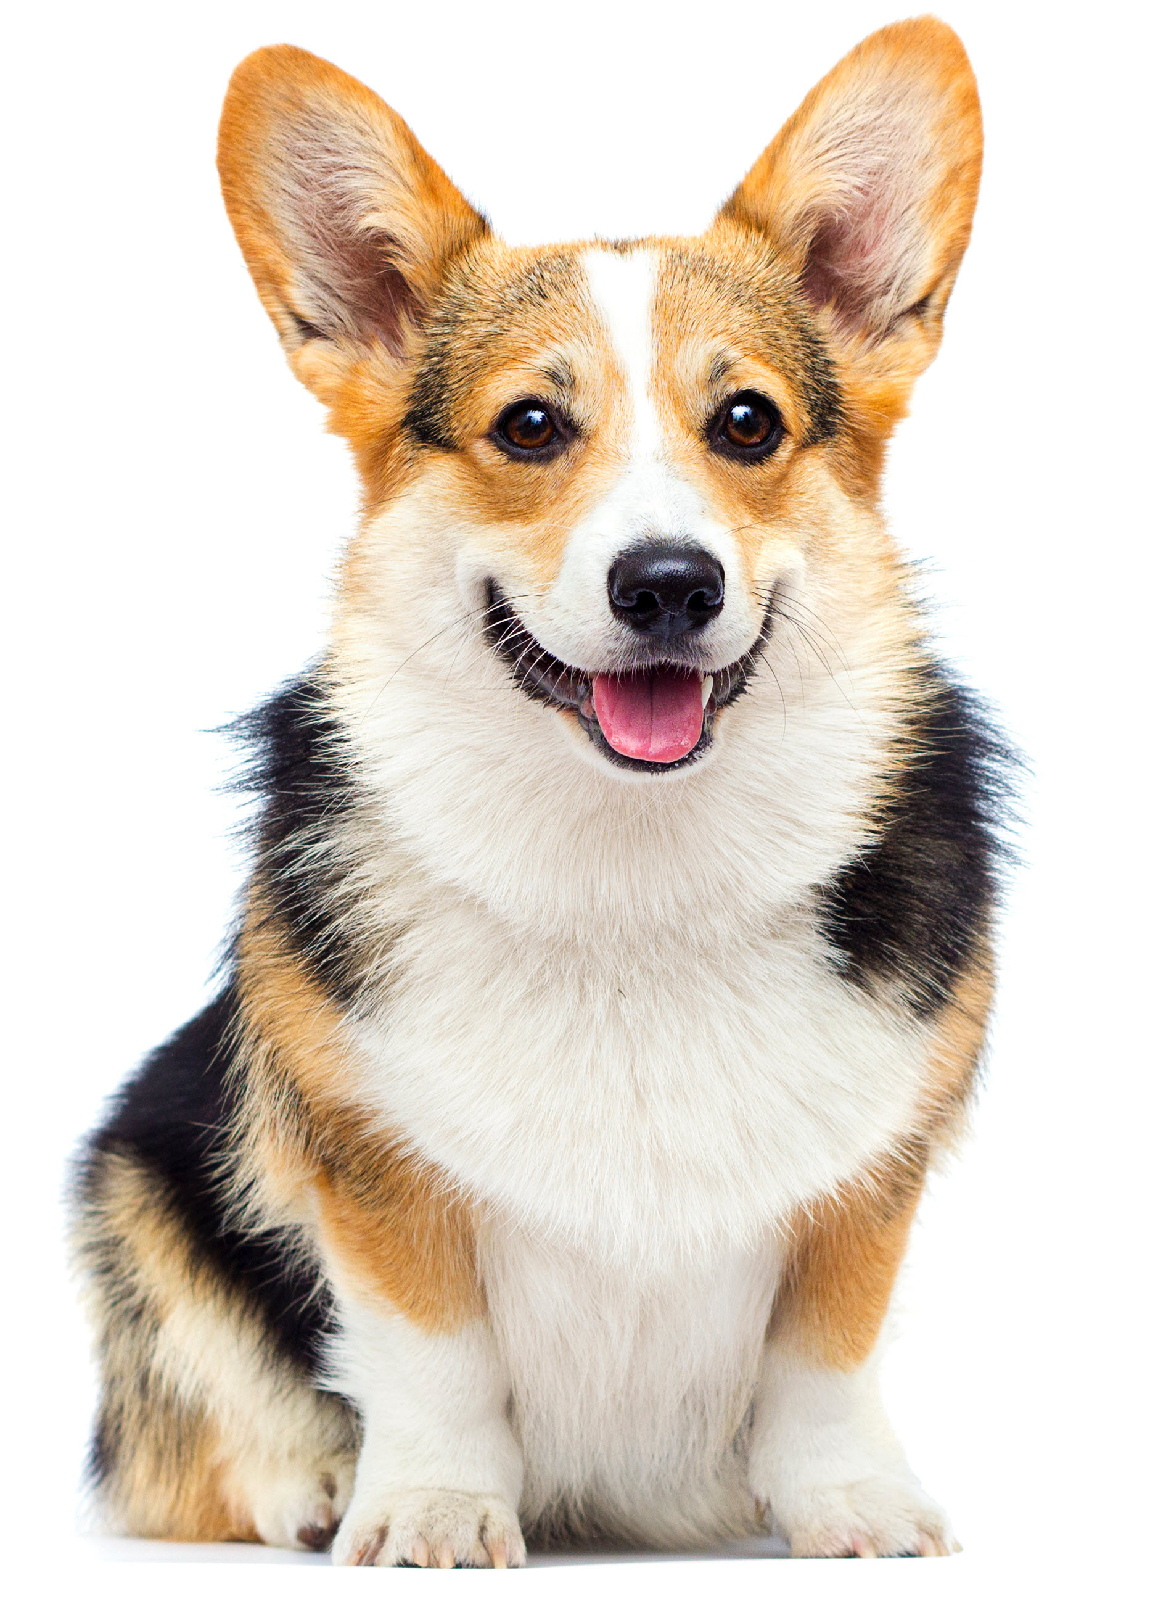

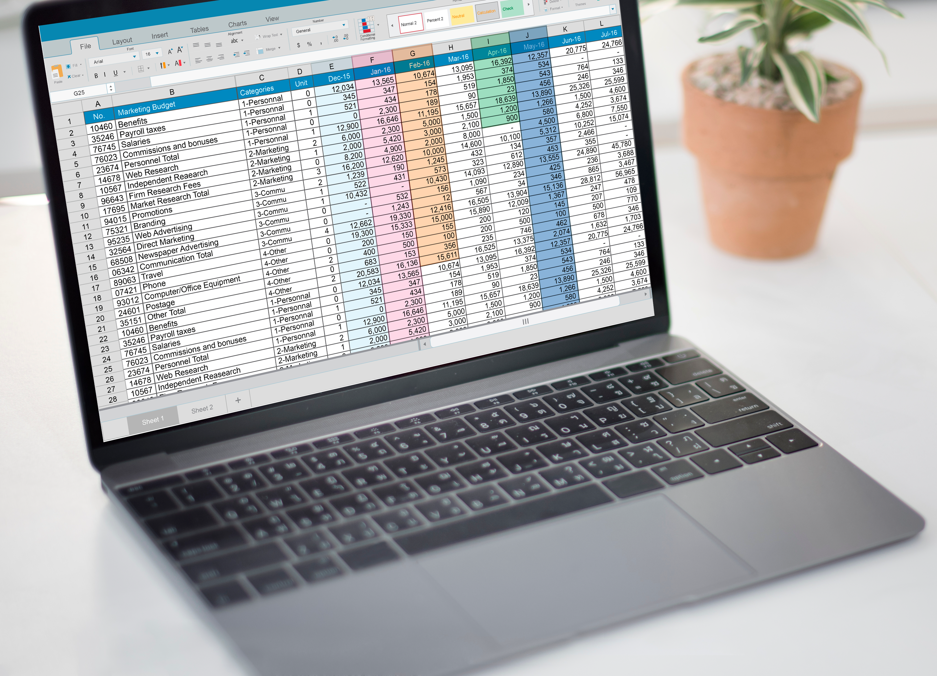
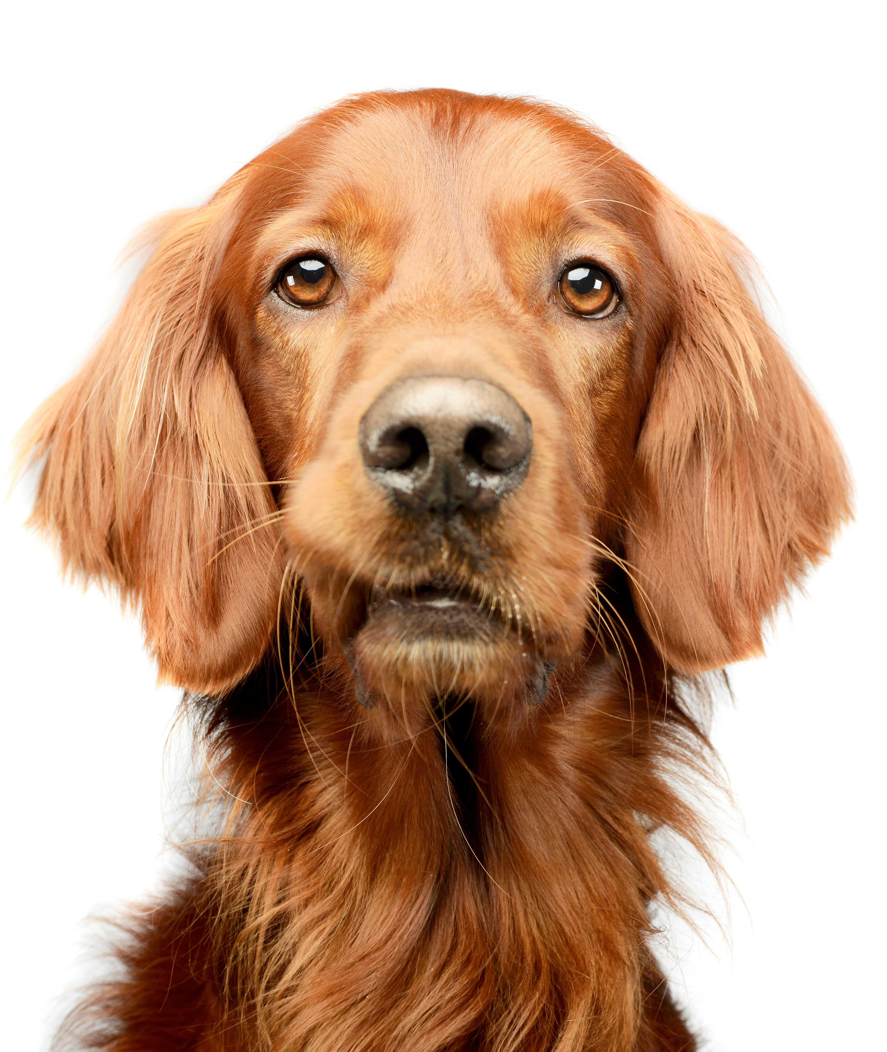

AutoGluon works for text and image tasks too
Tabular prediction
Image classification
Object detection
Text classification
Dog
Dog
Dog
Cat

Slide 14

Next: Labs
Lab 3: Train a model by using AutoGluon
Lab 4: Use the trained models to make predictions on new data
Lab 5: Optional challenge lab - Repeat those steps with more data and additional training time to significantly improve model performance
Let’s practice!

Slide 15
Module review

Slide 16
Module 1 review
Lesson | Topics
Lesson 0 | What is ML?, key components of ML, an example of using ML
Lesson 1 | Introduction to Jupyter notebooks and SageMaker
Lesson 2 | Data in ML, types of ML, aspects of successful ML problems
Lesson 3 | Common ML application domains, examples of ML applications
Lesson 4 | Introduction to the ML lifecycle, how models are evaluated
Lesson 5 | Introduction to AutoML and the AutoGluon library

Slide 17
Next module
Core topics in dealing with tabular data
Topics include: exploratory data analysis (EDA), data engineering, optimization, regularization, regression and tree-based models, and ensembling
See you in the next module!
Notes:
You will learn what is AutoML and how to use Jupyter notebooks with Amazon SageMaker to implement an AutoML tool called AutoGluon to solve an ML problem.

